Slide 1
Exercise 5
The total number of conductors in each parallel path of an 8-pole simple lap winding must be greater than 94 and less than 102. The number of slots per pole must also be greater than 12 and less than 18. Not less than 10 and not more than 15 equalizers must be used.

Slide 2
Determine the maximum number of conductors per slot: use z_{max}= 101 and s_{min}=13 [7.7= 6 since it should be lower and even]
and minimum number of conductors per slot : use z_{min}= 95 and s_{max}=17 [5.6= 6 since it should be higher and even]

Slide 3
and proceed to give the following details of a suitable winding:
  the number of conductors per slot [min = 6, max = 6 so ans = 6]
the no. of coil-sides per layer (u) if u >1 and the no. of turns in a coil [3 conductors in a layer implies 3x1 or 1x3 arrangement. Therefore u = 3 and no of turns = 1]

Slide 4
  the no. of slots [Since the no. of conductors per pole s ≤ 101 and ≥ 95, with 6 conductors in a slot, s_{max}=101/6 = 16.8 = 16 and s_{min}=95/6 = 15.8=16. Therefore s =16 and S = 16 x 8 = 128]
  the no. of commutator bars [= C= S x u=128 x 3= 384]

Slide 5
the number of equalizers
[Pitch of tapping points =(C/p) x(1/no. of equalizers) = (384/4)x(1/no. of equalizers) = 96/no. of equalizers.
For this to be an integer no. of equalizers must be 12]

Slide 6
  the coils which must be connected to equalizer no. 1 and equalizer no. 2.
  [C/p = 96 and pitch of tapping points = 96/12 = 8. Therefore to equalizer 1: 1, 97, 193, 289 and to equalizer 2: 9, 105. 201, 297]

Slide 7
Induced voltage in armature conductor
The variation of the emf generated in a conductor while it is moving through two pole pitches
  The emf remains constant while the conductor is moving under a pole and

Slide 8
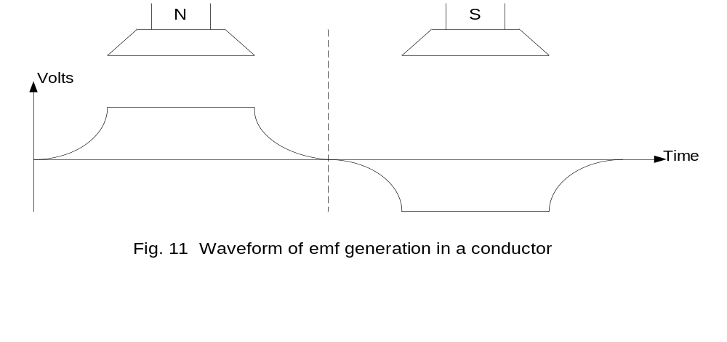
  Then decreases rapidly to zero when it is midway between the pole tips of adjacent poles.

Slide 9
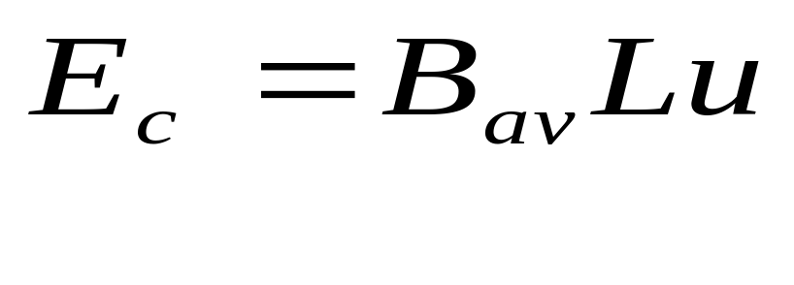
Induced voltage in dc armature windings
The average value of emf in a conductor when it is moving under a pole face is given by

Slide 10
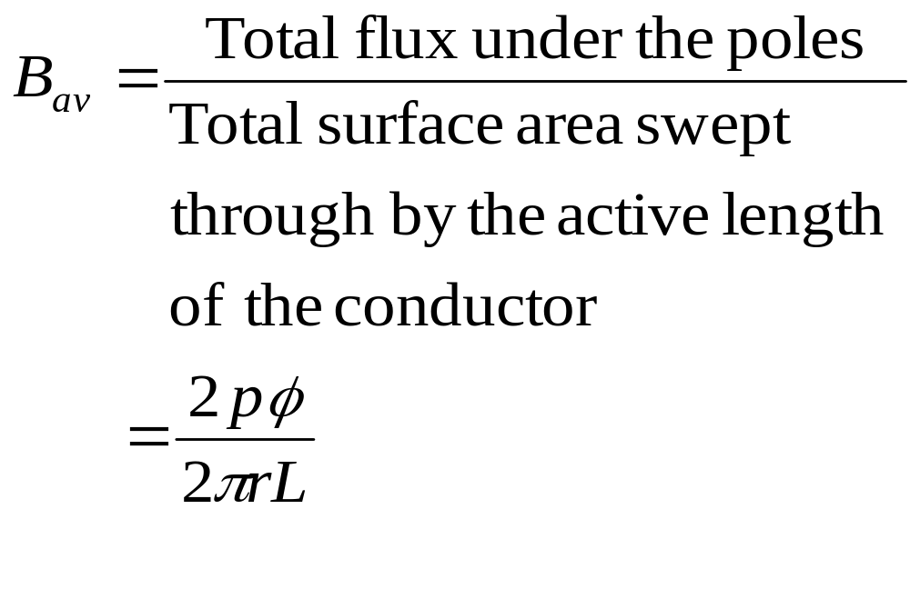
B_{av} = mean flux density

Slide 11
  L = active length of the
  conductor
  u = the surface speed of
  the armature
  r = radius of the armature
  core
  φ = flux / pole

Slide 12
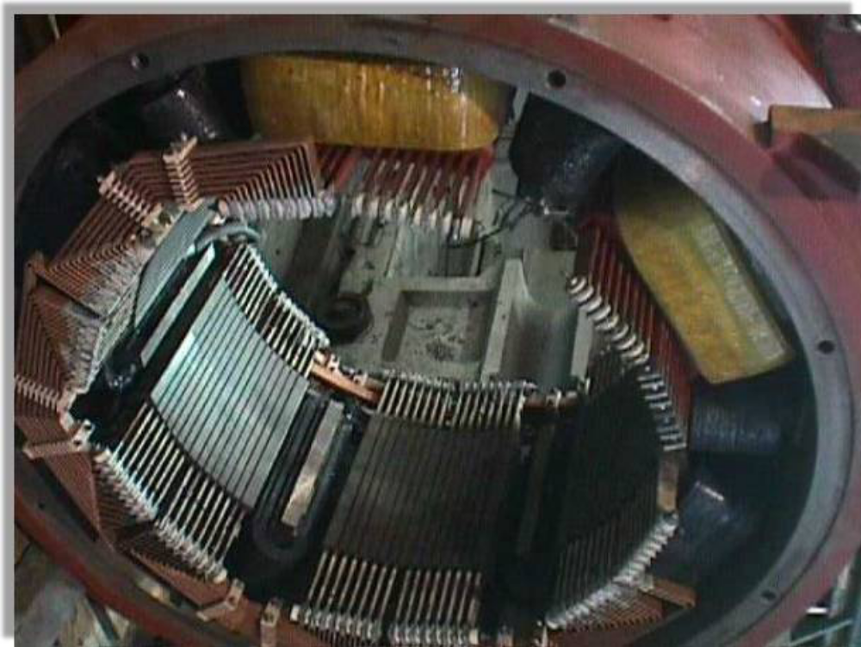

Slide 13
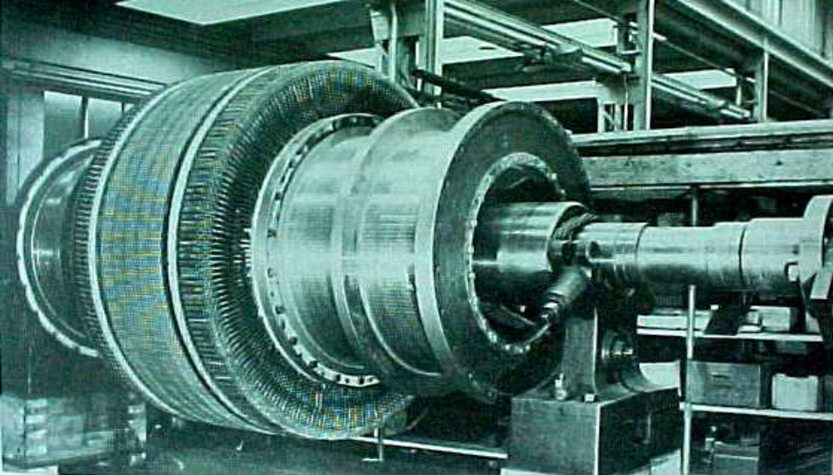

Slide 14
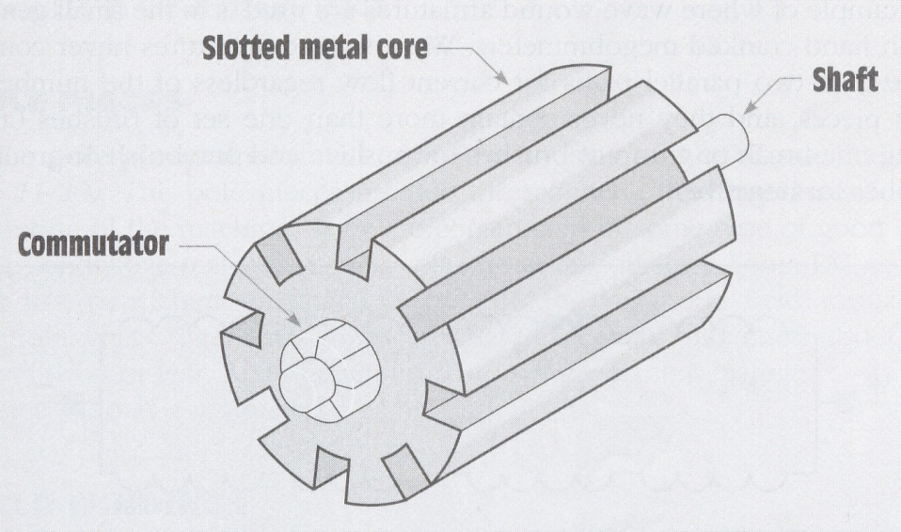

Slide 15
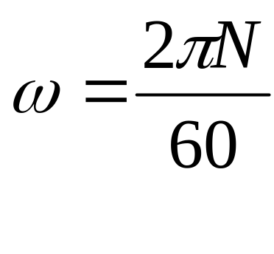
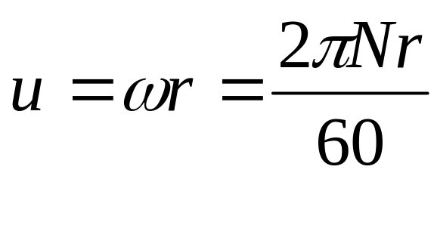
Let N = rotor speed in rev/min.
Then
And

Slide 16
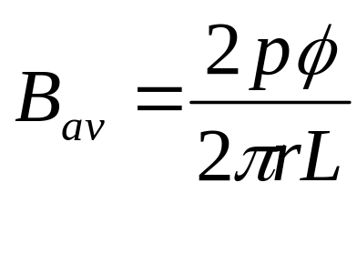
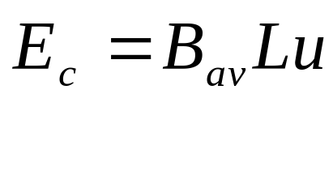
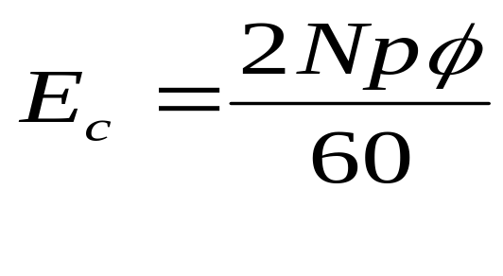
Substituting
and
Into
yields

Slide 17
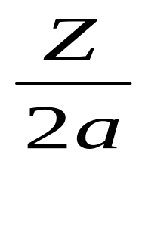
Let Z = total no. of conductors in a winding and
2a = c = no. of parallel paths.
Then the no. of conductors in series per path =

Slide 18
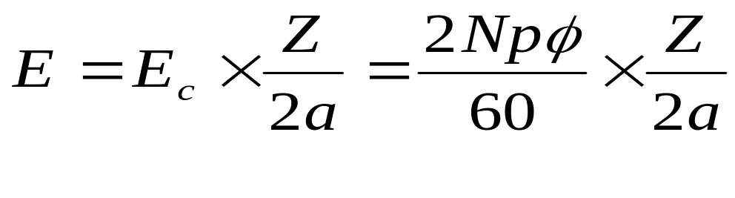
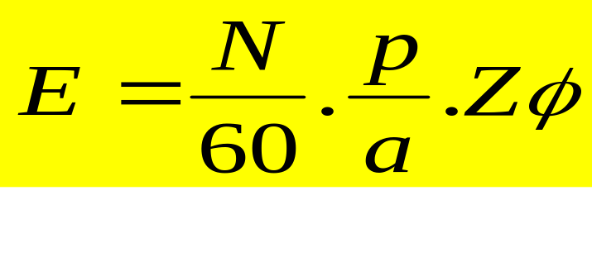
And the voltage induced between brushes is given by
a =1for simple wave winding and
a = p for lap winding

Slide 19
Comparing lap and wave winding machines
For a given no. of conductors and the same physical size and speed,
  the wave winding gives a higher terminal voltage and lower current than the lap winding.
  In general the lap winding is used for low-voltage, heavy-current machine.

Slide 20
Consider a 4-pole machine having 4 conductors.
  For the lap, no. of parallel paths
  = 4
  The terminal voltage V =
  voltage/conductor x no. of
  conductors /path = E_{c} x 1 = E_{c}

Slide 21
  Maximum current I_{max} = no. of
  parallel paths x maximum
  current/path = 4 x current rating
  of a conductor = 4I_{c} .
  Hence maximum power = 4E_{c}I_{c}
  For the wave, no. of parallel
  paths = 2 ,

Slide 22
  The terminal voltage V = voltage
  /conductor x number of
  conductors/path = 2E_{c},
  Maximum current I_{max} = number of
  parallel paths x maximum
  current/path = 2 x current rating of a
  conductor = 2I_{c} .
  Hence maximum power = 4E_{c}I_{c}

Slide 23
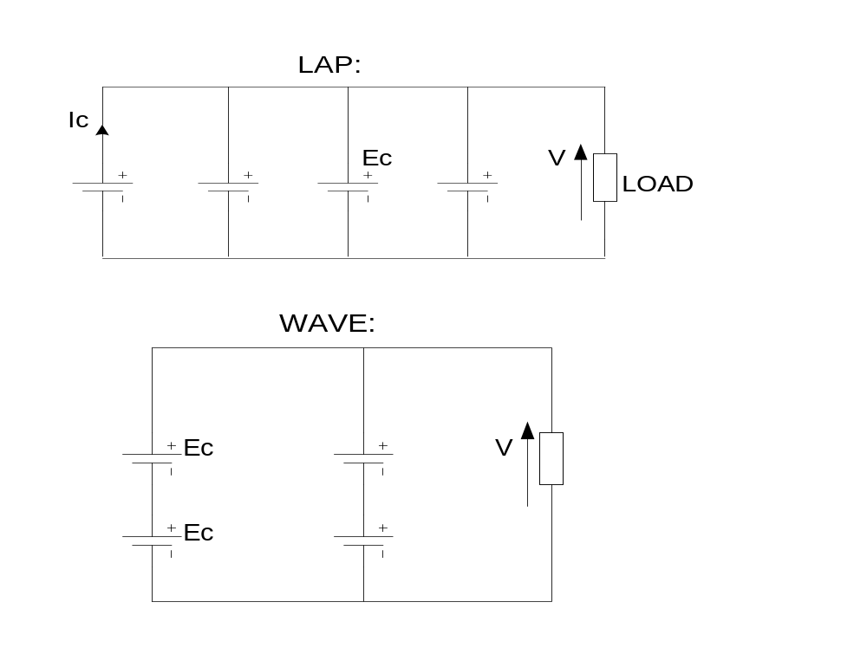

Slide 24
Numerical examples on commutator windings
A 6-pole simple-wave armature winding has 64 single-turn coils and 32 slots
Draw a slot showing the arrangement of conductors
State whether the winding should be progressive or retrogressive
Calculate the slot span and the coil pitch

Slide 25
Solution
Z = 64 x 2 = 128
Z_{s} = 128/32 = 4
u = C/S = 64/32= 2.
Use either the no. of conductors/ slot Z_{s} and the no. of turns or the no. of conductors/slot and u to draw the slot arrangement.

Slide 26
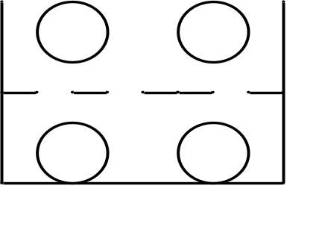
Commutator pitch y_{c} = (64-1)/3 = 21. Winding can only be retrogressive
Slot span = S/2p = 32/6 = 5.3 = 5
Coil pitch or coil span y_{b} = slot span x u = 5 x 2 =10 coil-sides

Slide 27
A 4-pole machine has a wave-wound armature with 576 conductors. Each conductor has a cross-sectional area of 5 mm² and a mean length of 800 mm. Assuming the resistivity for copper to be 0.0173 µΩm at 20°C and the temperature coefficient of resistance to be 0.004/°C at 0°C, calculate the resistance of the armature winding at its working temperature of 50°C.

Slide 28
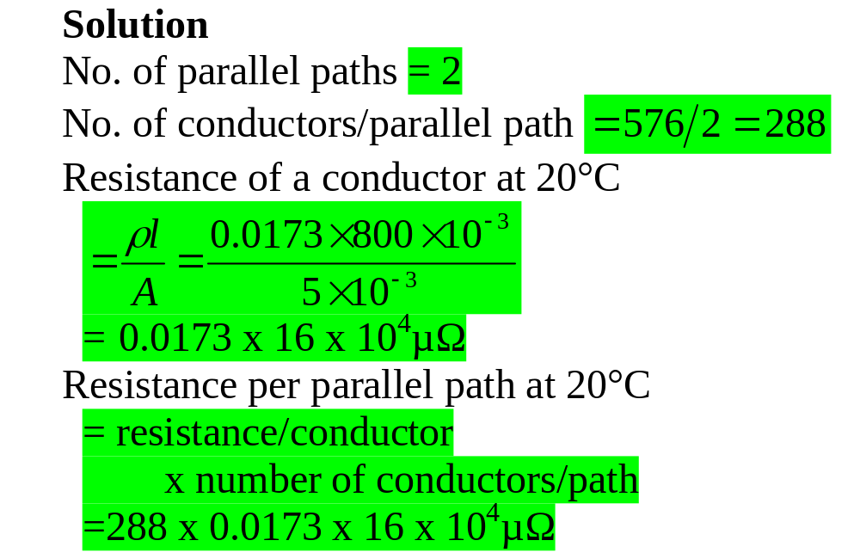

Slide 29
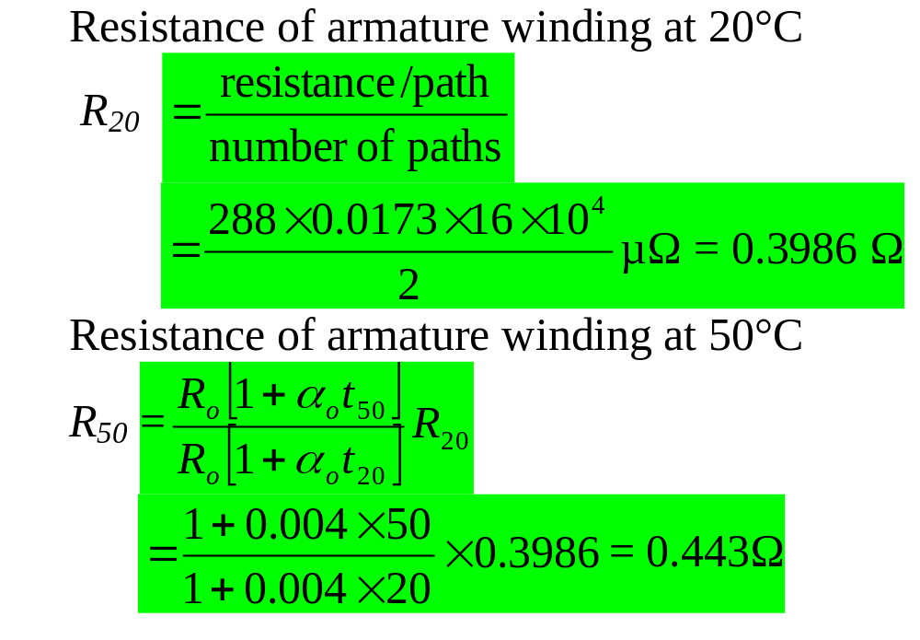

Slide 30
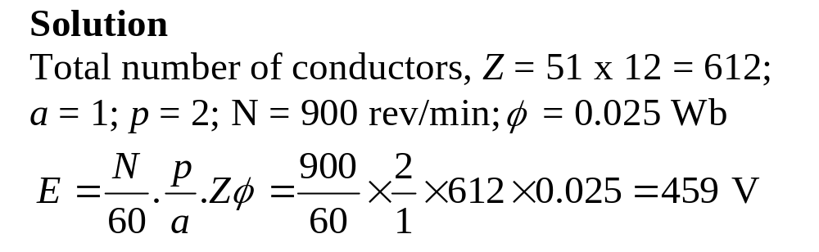
A four-pole wave–connected armature has 51 slots with 12 conductors per slot and is driven at 900 rev/min. If the useful flux per pole is 25 mWb, calculate the value of the generated emf

